Slide 1

Virtual Try-On
Zeinab sadeghian

Slide 2
outline
Introduction
Clothes’ virtual try-on
The approach taken in this project

Slide 3
Introduction
What is virtual try-on?
Why this subject?
What is Clothes virtual try-on

Slide 4
outline
Introduction
Clothes’ virtual try-on
The approach taken in this project

Slide 5
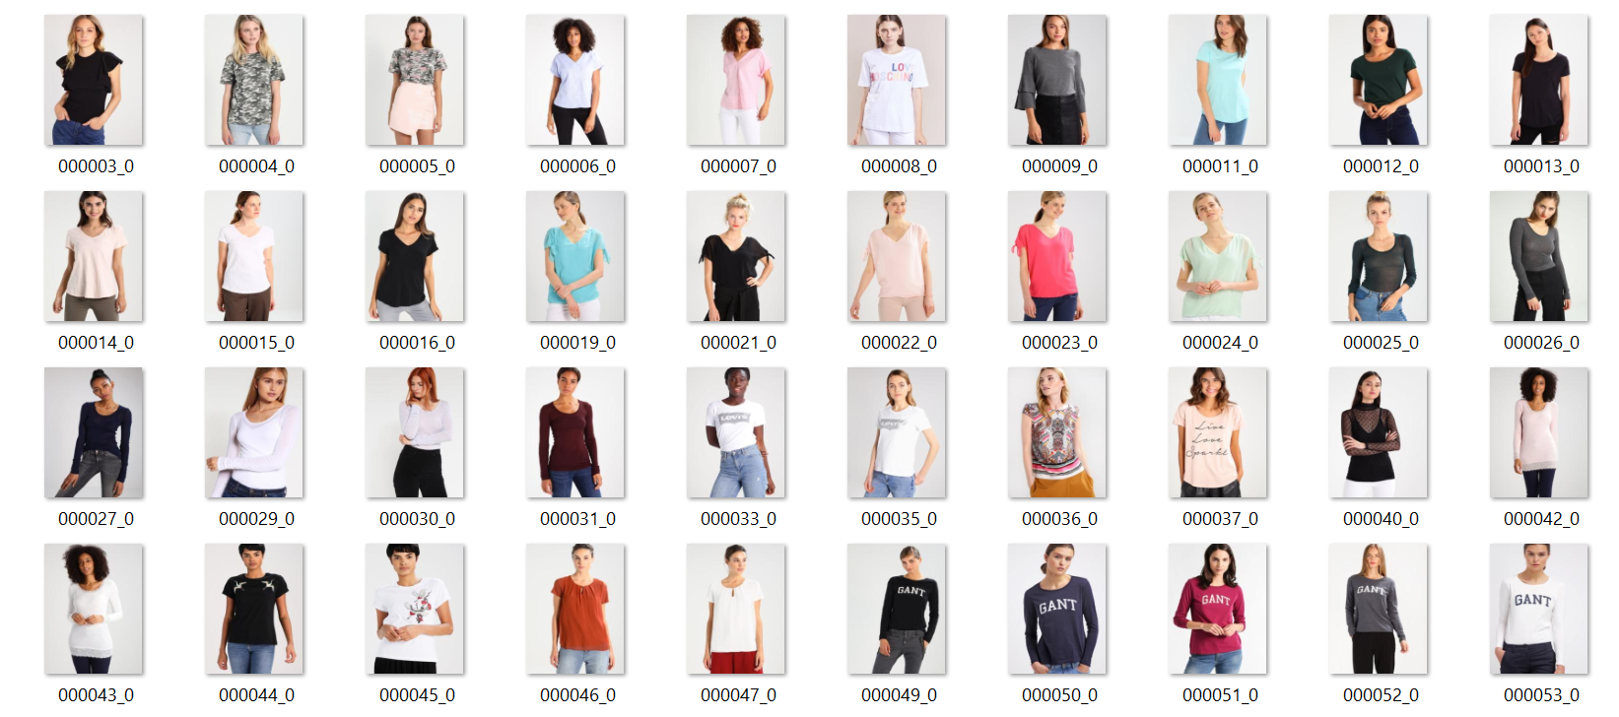
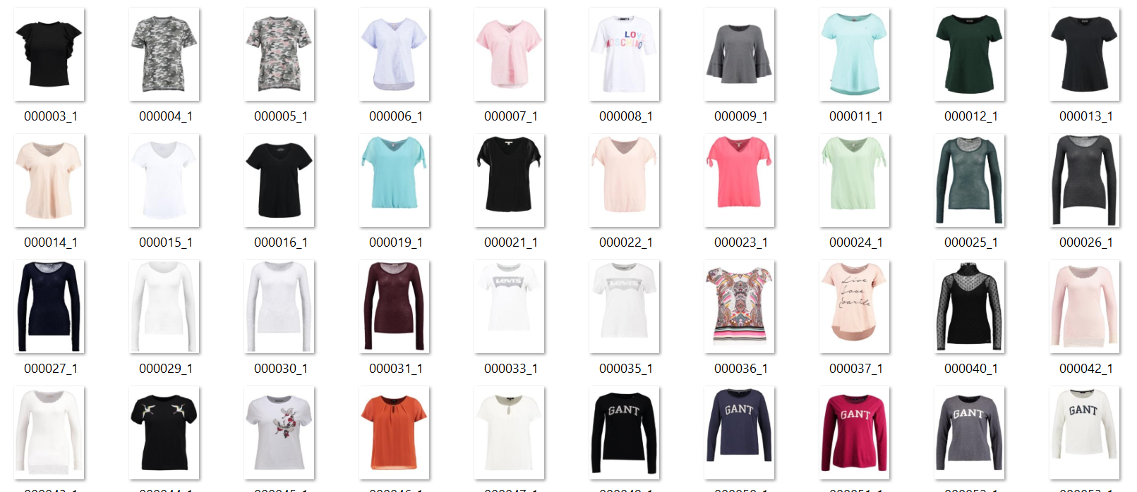
Clothes’ virtual try-on
Data
There are two previous approaches
VTON
CP-VTON

Slide 6
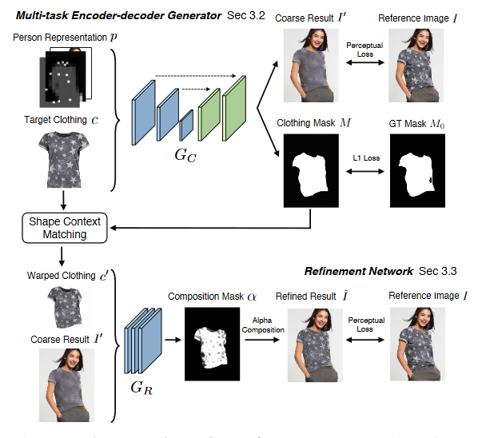
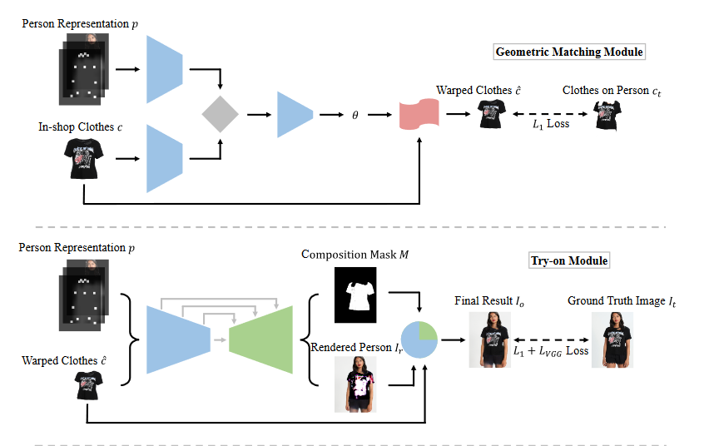
Two previous approaches
VTON
CP-VTON

Slide 7
outline
Introduction
Clothes’ virtual try-on
The approach taken in this project

Slide 8
The approach taken in this project
VFNP (An Image-based Virtual Try-on Network with Body and Clothing Feature Preservation)
Cloth wrapping module
New Segmentation Map Generation module
Synthesis module

Slide 9
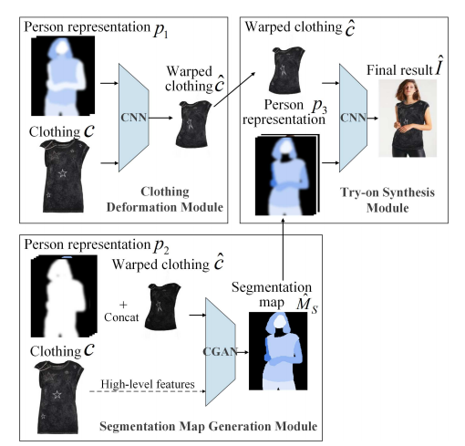
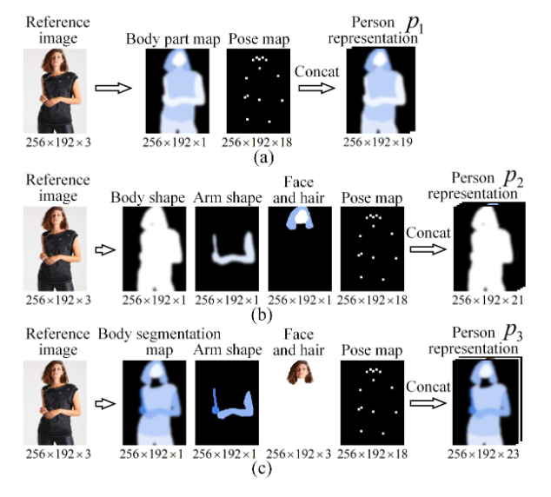
Person representation

Slide 10
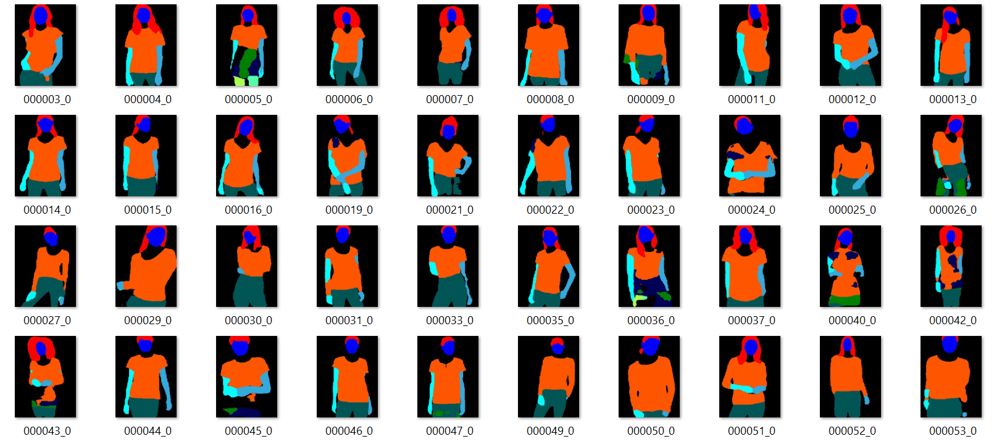
Person representation elements
Segmentation
LIP – look into person
Pose estimation
Openpose

Slide 11

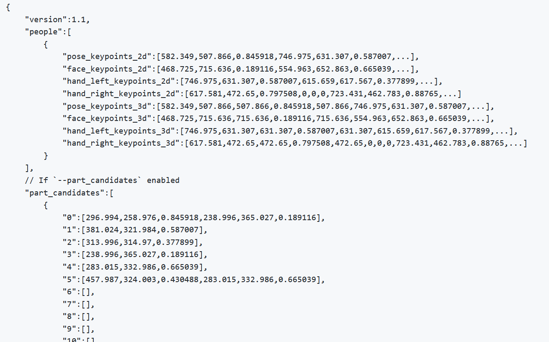
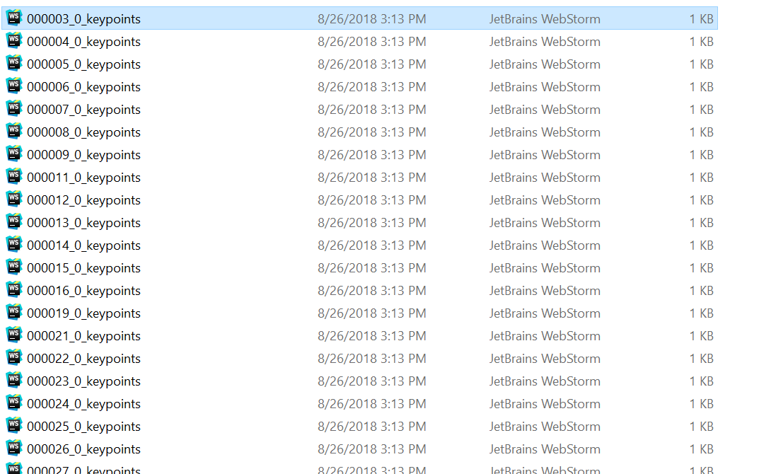
Openpose

Slide 12
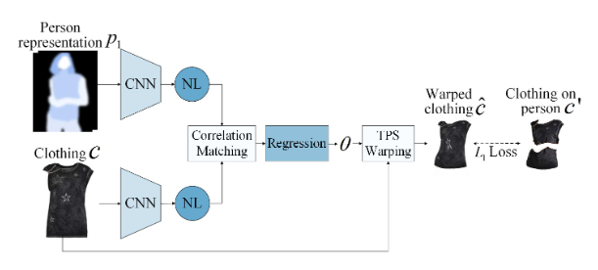
Cloth Wrapping Module

Slide 13
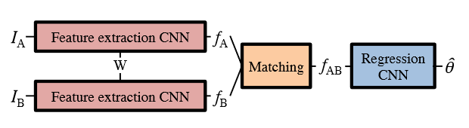
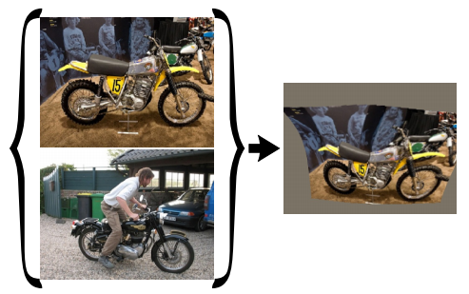
GEOMEtric matching
Architecture of geometric matching
Feature extraction
Matching network
Regression network
TPS ( thin-plate spline )

Slide 14
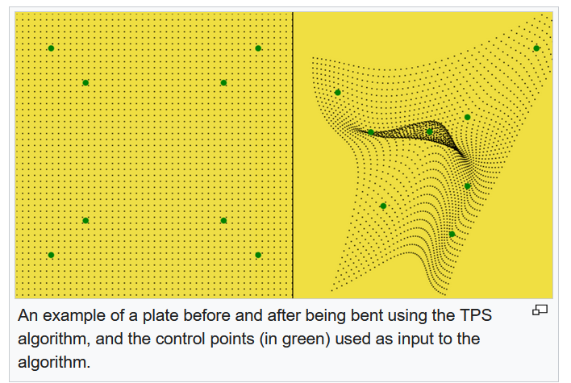
TPS

Slide 15
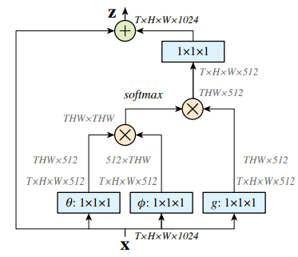
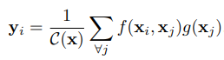
Non-local block
What is non-local block?
Non local operation

Slide 16
Cloth Wrapping Module

Slide 17
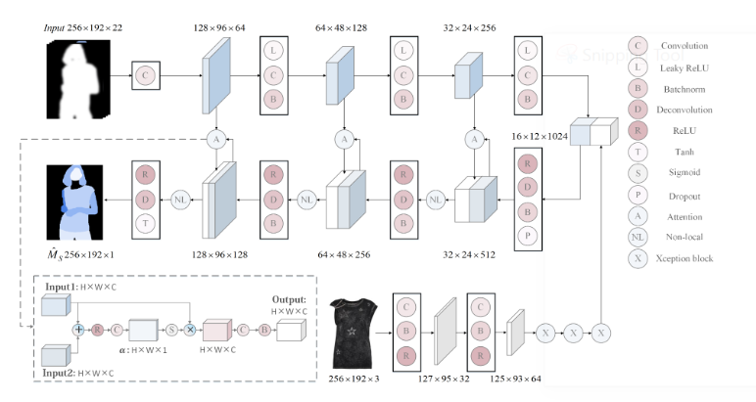
New Segmentation Map Generation module

Slide 18
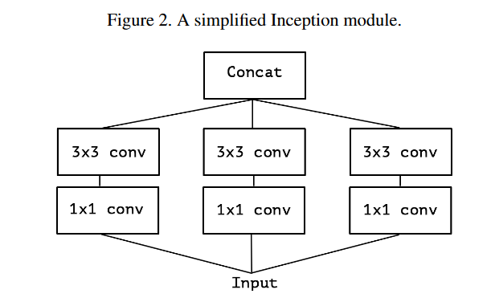
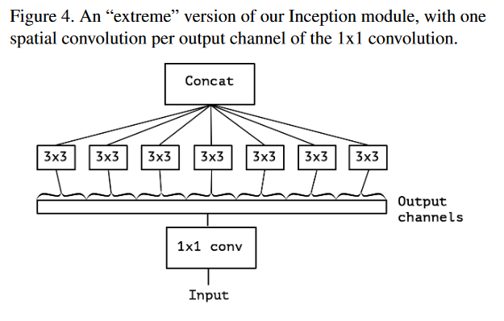
Xception block
Extreme inception!

Slide 19
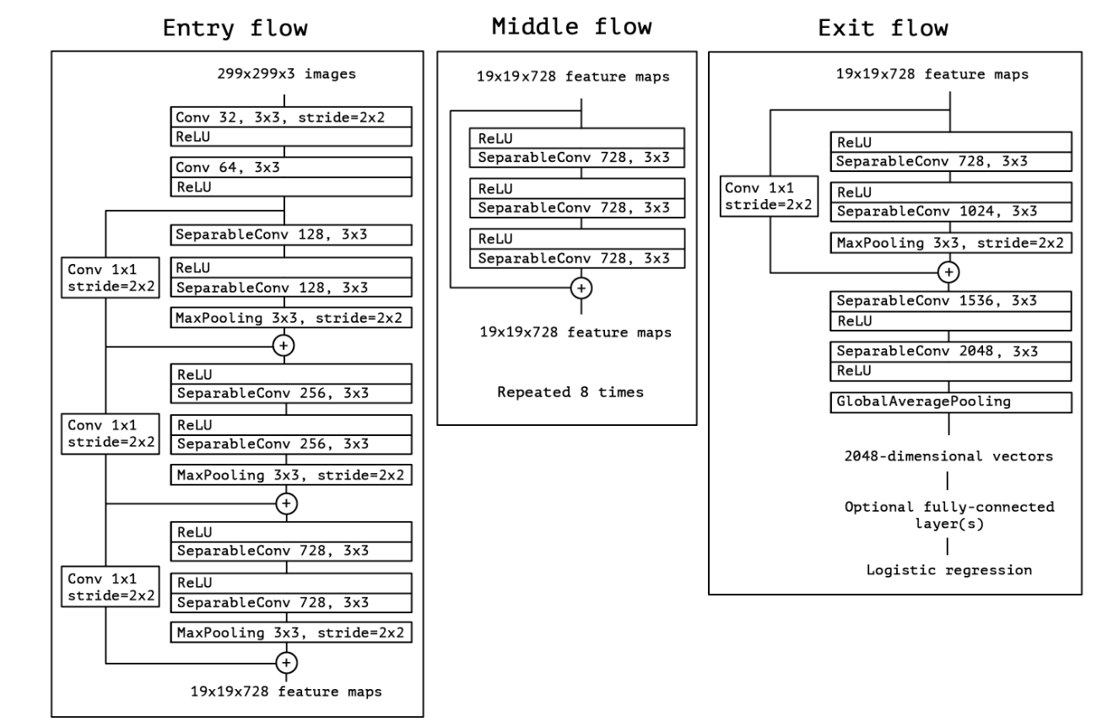
Xception block
Full architecture

Slide 20
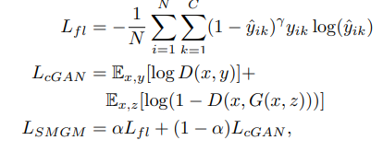
cGan loss
Final loss = focal loss + gan loss

Slide 21
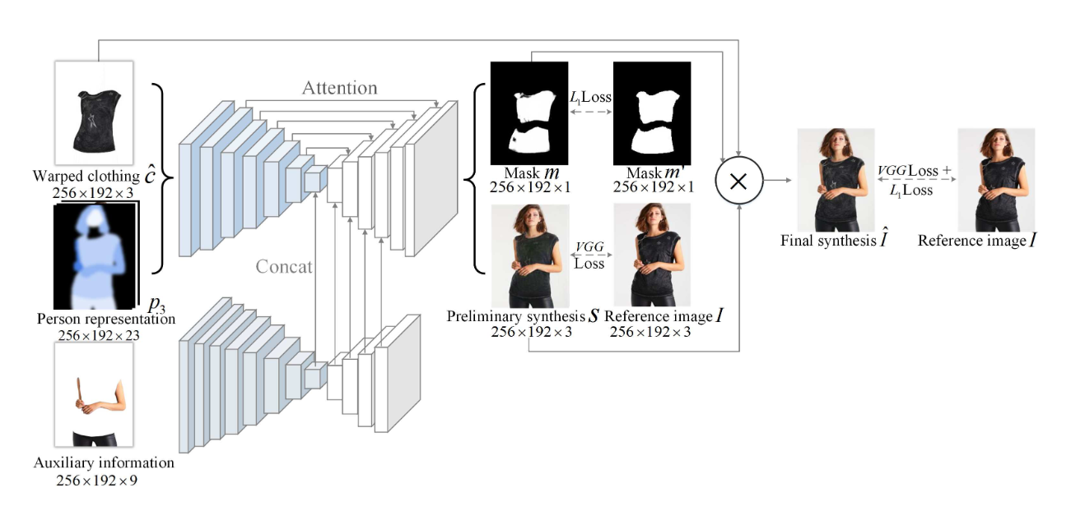
Synthesis module

Slide 22
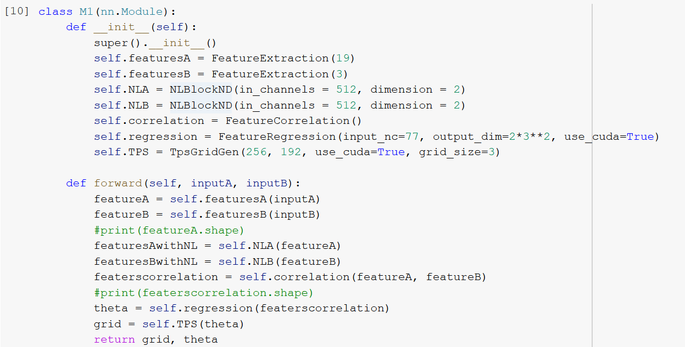
Results and implementation
Implementation details
First module
Optimizers
Betas
Epoches
Second module
layers
Alpha = 0.5
Epoches

Slide 23
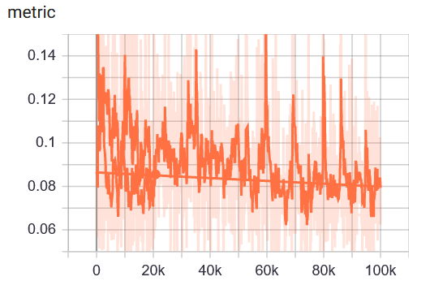
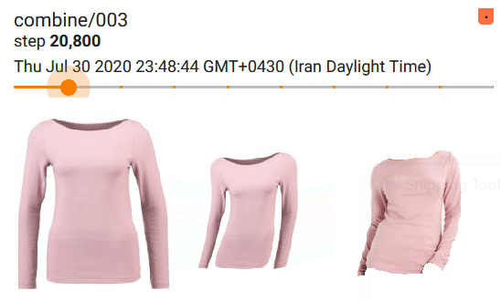
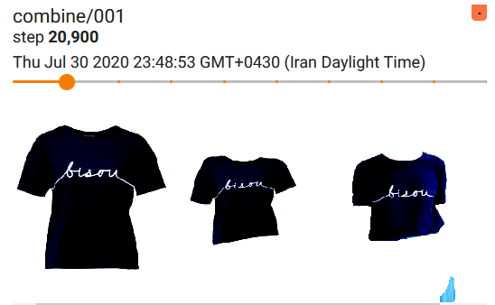
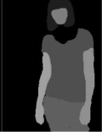
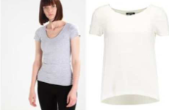
Results and implementation

Slide 24

Thanks for listening!

